Slide 1
ESPORTS PRIZE MONEY
A Data Story — KNIME Data App Documentation
WIW64030 Analytics for Data Driven Decisions— KNIME Data App Submission
To Prof. C. Laroque
Submitted by Ashwin Gopi (Matriculation No: 62192)
Dataset: Kaggle eSports Earnings — 1,000 players · 928 teams · 10 games

Slide 2
THE STORY
Prize money is concentrated —
not evenly spread.
Concentrated in a handful of games, a handful of countries, and a long tail of teams that convert tournament activity into cash at wildly different rates.
01
02
03
Global Landscape
Player Spotlight
Team Efficiency
Where the money concentrates across games, genres, and regions.
Who earns it, and how skewed individual earnings really are.
Which teams convert tournaments into prize money most efficiently.
KNIME Data App — eSports Prize Money
2

Slide 3
DATA SOURCES
Three files, one relational structure
1,000
928
262
PLAYERS
TEAMS
REFERENCE ROWS
highest_earning_players.csv
highest_earning_teams.csv
country-and-continent-codes-list.csv
Handle, country code, total USD prize, game, genre.
Team name, total USD prize, tournament count, game, genre.
ISO country codes mapped to continent — used to enrich players geographically.
KNIME Data App — eSports Prize Money
3

Slide 4
DATA PREPARATION
Cleaning and joining, done once, feeding all 3 views
1
Normalize country codes
2
De-duplicate the reference table
String Manipulation → uppercase CountryCode so it matches the reference table's casing.
8 codes (RU, TR, GE, AZ, AM, CY, KZ, UM) appear twice — tagged to two continents. Removed before joining to avoid row fan-out.
3
Join players to geography
4
Derive efficiency metric
Joiner (left outer) attaches Continent_Name and Country_Name to every player row.
Math Formula: PrizePerTournament = TotalUSDPrize / TotalTournaments, for teams.
5
Rank within game
6
Aggregate for the macro view
Rank node, partitioned by Game, on TotalUSDPrize — run for both players and teams, powering "top N per game" views without hardcoding.
GroupBy per Game/Genre/Continent → prize totals and counts feeding View 1.
KNIME Data App — eSports Prize Money
4

Slide 5
DATA QUALITY CHECK
Catching a silent join bug before it skews the numbers
The reference file tags 8 transcontinental countries (Russia, Turkey, Georgia, Azerbaijan, Armenia, Cyprus, Kazakhstan) to two continents each. A naive join duplicates every player from those countries.
WITHOUT DEDUP
WITH DEDUP (APPLIED)
Players from RU/TR/GE/AZ/AM/CY/KZ appear twice in the joined table
Duplicate Row Filter on the reference table, keyed on country code, keep-first
Country and continent totals for those nations are inflated 2x
Every player joins to exactly one continent
Any chart grouped by Continent or Country silently misreports
Applied inside the "Data Prep" component, before any downstream aggregation
KNIME Data App — eSports Prize Money
5

Slide 6
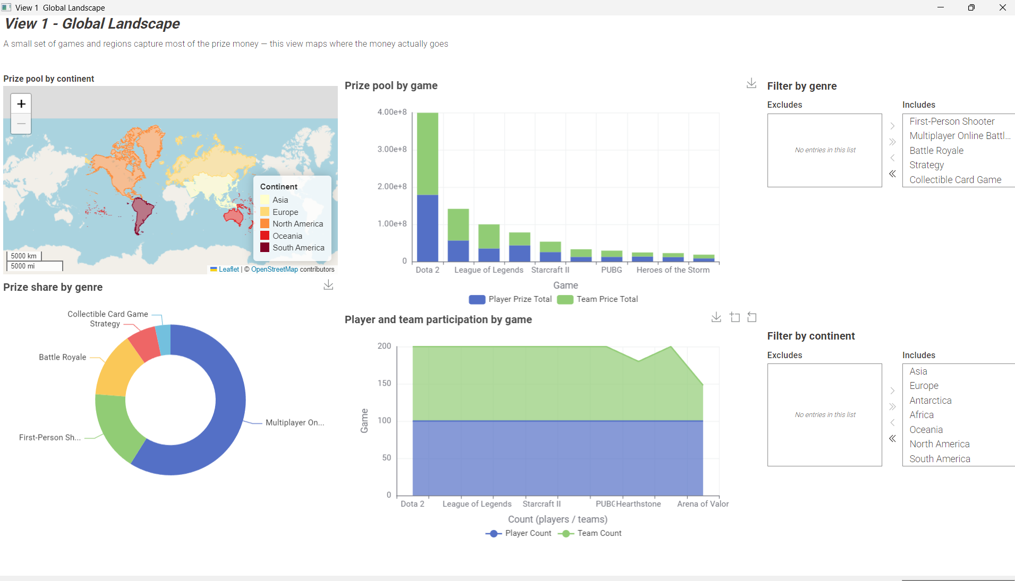
VIEW 1
Global Landscape
“Where the money is” — setting the macro picture before drilling in
VISUALIZATIONS
Stacked Bar chart: total prize pool by Game
Donut chart: prize pool share by Genre
World Map: total prize by Continents
Stacked Area chart : player vs. team prize pool per game
FILTERS
Genre (value filter)
Continent (value filter)
KNIME Data App — eSports Prize Money
6

Slide 7
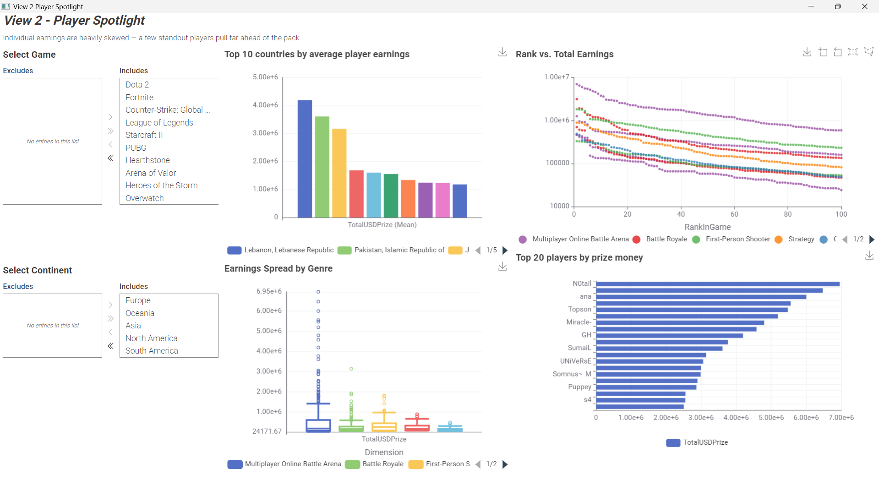
VIEW 2
Player Spotlight
“Who’s actually winning” — individual earnings and how skewed they are
VISUALIZATIONS
Bar chart: average player earnings by top 10 countries
Scatter: in-game rank vs. earnings, colored by genre
Box plot: prize distribution by genre
Bar chart: top 20 players by total prize
FILTERS
Game (value filter)
Continent (value filter)
KNIME Data App — eSports Prize Money
7

Slide 8
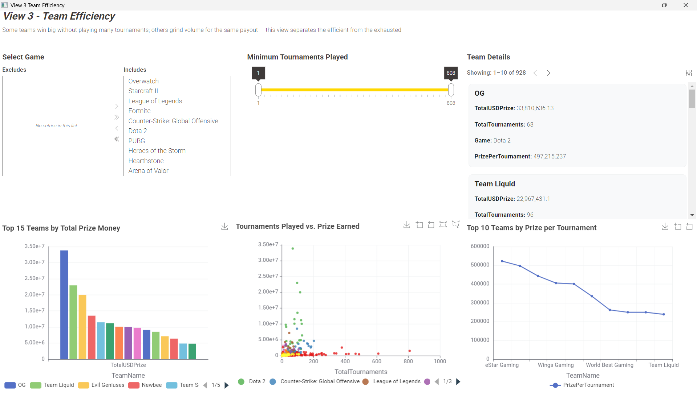
VIEW 3
Team Efficiency
“Grinding vs. winning” — which teams convert tournaments into cash
VISUALIZATIONS
Bar chart: top 15 teams by total prize
Scatter: tournaments played vs. total prize, by game
Line chart: top 10 teams by prize-per-tournament
Detail table linked to scatter selection
FILTERS
Game (value filter)
Minimum tournaments (slider)
KNIME Data App — eSports Prize Money
8

Slide 9
SELF-ASSESSMENT
How this app meets the evaluation criteria
Rubric item | How it's addressed
Meeting requirements | 3 views × 4 visualizations × 2 filters each, within the 2–5 / 1–3 ranges
Independence | Country-code casing and duplicate-continent-row issues identified and resolved without external help
Usability | Consistent filters, cross-page navigation, View 3 drill-down, safe empty-filter fallback
Data transformation | Normalization, dedup, geo-join, derived PrizePerTournament and per-game rank — isolated in a labeled Data Prep component
Visualization clarity & relevance | Every chart maps to one line of the concentration narrative, not a chart per column
KNIME Data App — eSports Prize Money
9

Slide 10
Thank you
Workflow export (.knar) and this documentation deck submitted together

